Slide 1
A brief introduction of soft skills we have developed co-working
We decided to create an online repository on GitHub in order to have a remote copy of our working folder. Then, thanks to a proper software (Git) we have started to push our results, update them and retrieve our colleague work. (For further details: https://github.com/simonelucchesi/Corporate-project-)
Even thanks to this practice we have improved our capability of co-working, speaking through Skype (sharing our screens).
Most of analytics was developed on Jupiter Notebooks (Python programming), we found it very useful for making data analytics. (For further details: see Notebooks section)
We have improved our Excel knowledge: in fact, most of analytical results were translated into it, in order to have a better view of all our work.
Co-work notwithstanding, we also have developped a personal critical approach. In fact, forecasts were made individually.

Slide 2
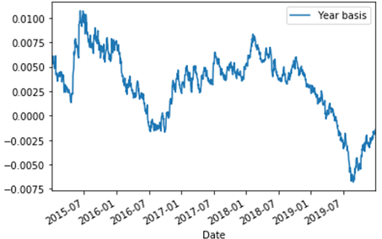
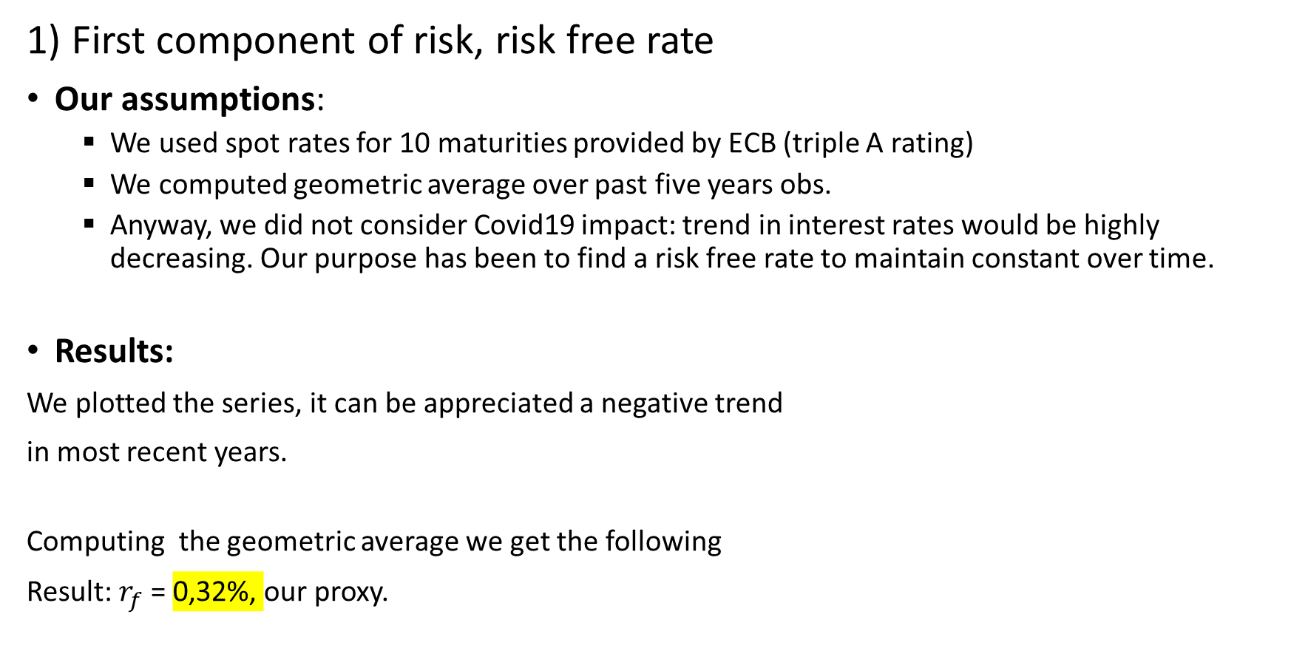
Risk fundamental analysis: our way of computing cost of equity and cost of capital for A2A.
1) First component of risk, risk free rate
Our assumptions:
We used spot rates for 10 maturities provided by ECB (triple A rating)
We computed geometric average over past five years obs.
Anyway, we did not consider Covid19 impact: trend in interest rates would be highly decreasing. Our purpose has been to find a risk free rate to maintain constant over time.
Results:
We plotted the series, it can be appreciated a negative trend
in most recent years.
Computing the geometric average we get the following
Result: $r_{f}$ = 0,32%, our proxy.

Slide 3
CAPM: market and country risk premiums
Assumptions:
Due to the fact we considered European spot rates, German stock market represents a candidate: by consistency we computed market risk premium using Dax average log return over past 5 years.
Anyway, country risk premium component must be included for Italy: we have used a rescaled CDS (starting from 170 BP) by standard deviations on Italian stock and bond markets.
In the detail we computed std of FTSE MIB 40 log returns over past 5 years; the same for an Italian BTP with time to maturity 10 years (BTP –May31).
We have decided to not include Covid-19 effect into cost of equity but to apply it differently in our forecast.

Slide 4
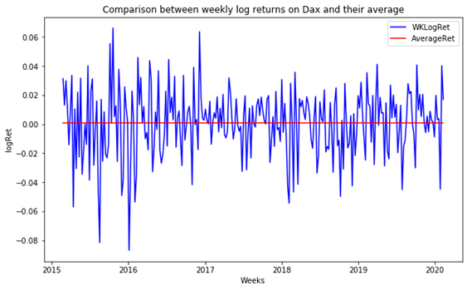
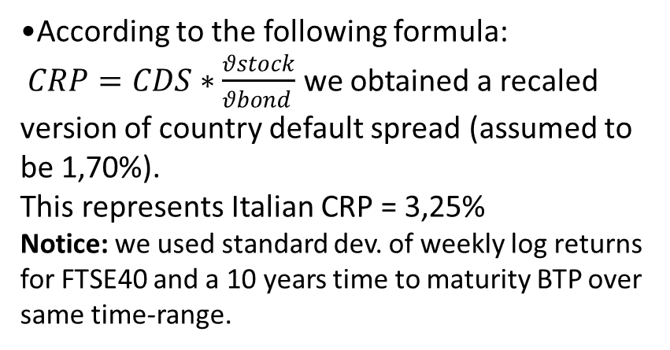
Cost of equity and cost of capital: results
•After computed geometric average of Dax weekly log returns and converted it into annual we subtracted risk free rate to obtain a proxy for stable market risk premium = 4,54%. (This according to the logic that Beta should be 1)
•According to the following formula:
$CRP=CDS∗\frac{θstock}{θbond }$ we obtained a recaled version of country default spread (assumed to be 1,70%).
This represents Italian CRP = 3,25%
Notice: we used standard dev. of weekly log returns for FTSE40 and a 10 years time to maturity BTP over same time-range.
Adding together previous results we get an equity risk premium for Italian stock market of 7,79 % .
Damodaran provides an equity risk premium of approximately 10 %, of course he used different inputs in his analysis; furthermore this result is affected by Covid outbreak.

Slide 5
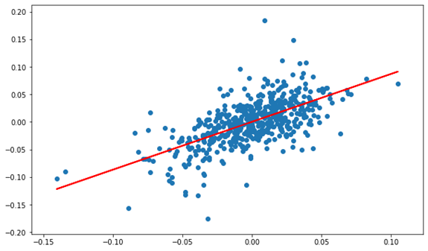
Third component: levered regression beta
For publicly traded firms it's straightforward to estimate returns an investor would have made on its equity over a given period.
This can be done by using a regression method, in our case OLS method, 1st order.
Our assumptions
Length of estimation: we have decided to use past 10 years obs (excluding Covid effect)
Return interval: due to trade off between estimation bias and lack of information we used weekly obs.
Market index proxy: we regress A2A weekly log returns against FTSEMIB40 weekly log returns.
•Results
As represented we found a positive correlation between A2A returns and FTSEMIB’s.
These are the output of regression:
Intercept = 0,0003
Slope = Regression Beta = 0,868
It’s interesting to notice that Reuters provided a Beta of 0,89. Regressing against EuroStox50 we got a beta of 0,867.

Slide 6
What about bottom-up Beta?

